Slide 1
The Rulebook for Fair Data Economy
Marko Turpeinen & Olli Pitkänen
1001 Lakes

Slide 2
Rulebook Data-Sharing Starting Points
Privacy
Fairness & Ethics
Data Economy & Business
Growing Ecosystems
Easier Network Setup
Common “DNA”
Data protection
Technology Framework
Legal System

Slide 3
Diverse Workgroup
Sitra – a public fund – the initiator
Companies
Universities
Authorities
Subworkgroups
Ethics
Marketing
Technology – ”toolification”
Legal

Slide 4
Legal System
Business
Data Network – Rulebook
General Part
Constitutive Agreement
Check List
Description of Data Network
Externals:
Individuals
Legal entities
Others
Data Sources
Data Subjects
Subscribers
General Terms & Conditions
Ethics
Code of Conduct
Governance Model
Glossary
Other Appendices
Parties
Accession Agreement
Parties
Parties
- Members
Data Sets
Terms of use
Technology
Roles

Slide 5
Checklist
Rulebook checklist
Business
Value and utilization of data
Data Rights
Legal
Contractual principles
Governance
Liabilities
Content
Technology
Infrastructure and common solutions
Core functionality
Administration
Data
Governance
Data structure
Ethics
Security
Commitment to ethical practices
Transparency and communication
Sustainability
Human-centricity
Far networking
Purpose

Slide 6
Examples of rulebook use cases

Slide 8
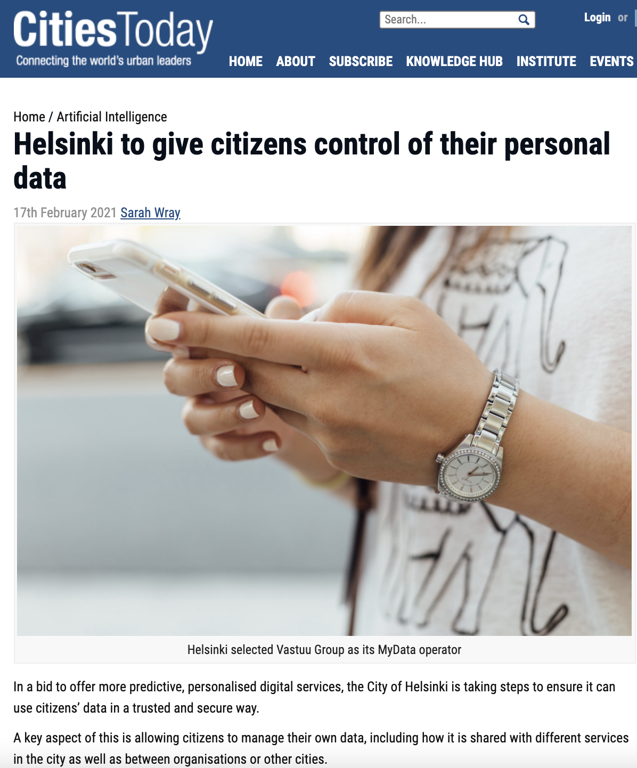

Slide 9
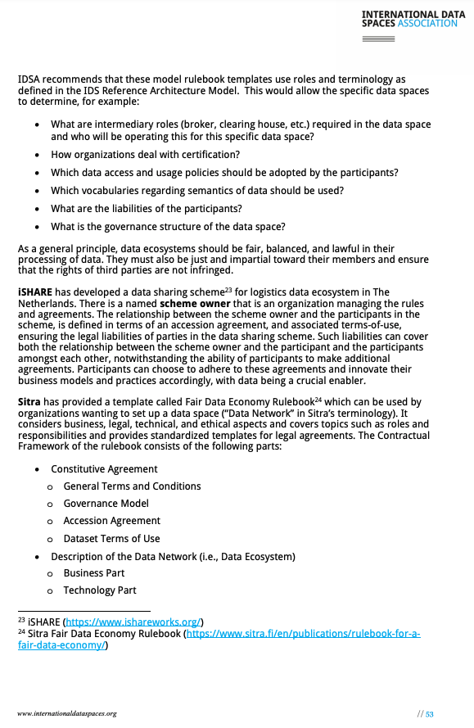

Slide 10
Thank You!
Olli Pitkänen
olli.pitkanen@1001lakes.com
Marko Turpeinen
marko.turpeinen@1001lakes.com

