Slide 1
Maximizing control and reuse over data: why and how
David Osimo, the Lisbon Council

Slide 2
Overcoming the tradeoff bettween control and reuse
High control
Data protection
New EU data strategy
Pre GDPR
Low reuse
High reuse
Low control

Slide 3
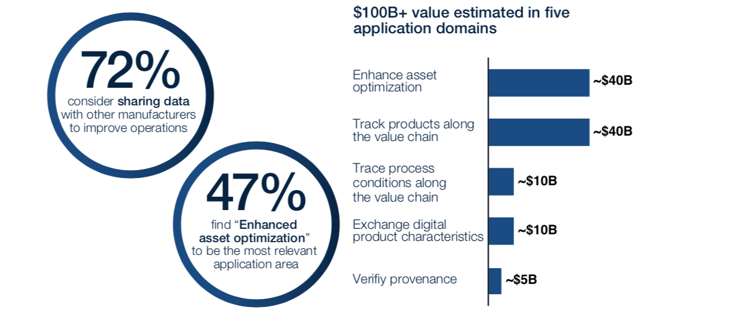
The data sharing opportunity: 80% of the data opportunity
Source: Vodafone study by Deloitte

Slide 4
THE BARRIERS
How to solve it – at scale?

Slide 5
The solutions
Instruments | Status
Sectoral data standards | More mature within sectors, not across. More mature governance.
Metadata standards (esp. ML) | Individual solutions (Microsoft, Google), industry initiatives
Data sharing schemes | Pilots, industry initiatives, specific use case implementation
Interoperability across sector | Implemented only in specific domains (e.g. FAIR data in science)
MATURITY
COMPLEXITY

Slide 6
Fast moving landscape, new solutions being piloted
Estonia X-Road

Slide 7
In conclusion…
You don’t need a EU data space to start sharing data.
Thank you
david.osimo@lisboncouncil.net

