Slide 1
NORDIC INDIGENOUS TK&IP CONFERENCE - TEAM BRIEFING 2 - 16.4.2021
Political, technical and substantive goals
Anna Vuopala
Questions? Please contact: anna.vuopala@minedu.fi

Slide 2
State of Play
Nordic Team 12.3 – notes
Nordic Team 16.4 - New experts invited
WIPO colleagues
Colleagues from the archives
Inuit representatives
New materials added to the portal
”The Saami traditional dress & beauty pageants: Indigenous peoples’ rights of ownership and self-determination over their cultures” by Mattias Åhren
Indigenous People’s status in the international legal system; Mattias Åhren
“Ofelaš – the pathfinder: Guidelines for Responsible Filmmaking with Sámi Culture and People” by International Sámi Film Institute
Ethical guidelines for Sámi Health Research (in Norwegian)
Regulations on the protection of traditional knowledge related to genetic material (in Norwegian): Forskrift om beskyttelse av tradisjonell kunnskap knyttet til genetisk materiale - regjeringen.no

Slide 3
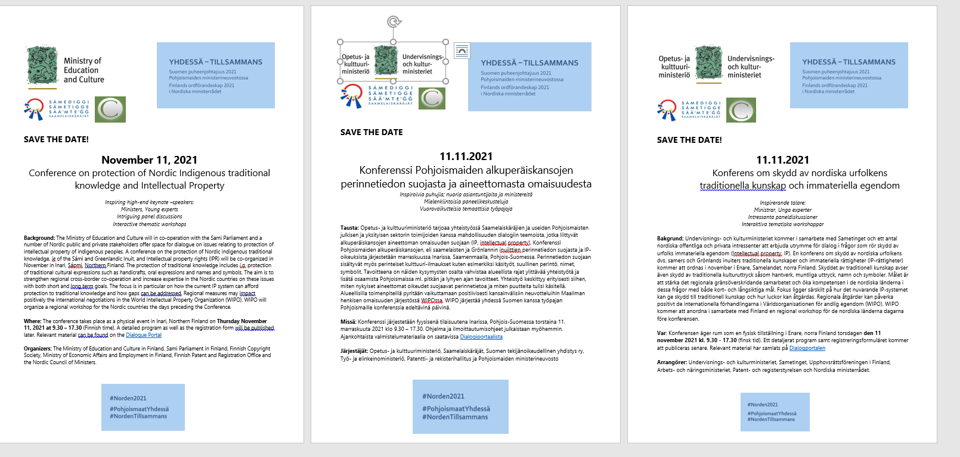
Save the dates

Slide 4
NORDIC INDIGENOUS
PEOPLE
Russia
Norway
Constitution
Finland
Sami parliament in Sweden
Constitution + Act on Sami Parliament, Sami language act mm.
Sweden
Constitution
Sami parliament
in Norway
Saami council
ICC
Sami people &
Greenland inuits
IP Offices
Countries positive about increased cooperation,
good idea to aim for a greater consensus between the Nordic countries
- better communication
with SPC
- Discussion within the framework of existing forums
Finnish
Heritage
Agency
TK&IP?
FI, SE, NO
- IP legislation, no
specific
indigenous aspect
Sami
parliament
in Finland
Denmark
Greenland, ”greenlanders”
Self-government:
Legislation on the protection of
Inuit genetic resources
Sami
villages
Skolt Sámi
Giellagas
National
archives
Faro Islands
Sami organisations
Iceland
Sami Duodji

Slide 5
Draft Program for the Conference
Date 11 November 2021, Inari, Sajos centre, physical event
Decision: early June relating to format
Timeframe: 8.30 – 16.30 CET (9.30 – 17.30 EET)
High level – opening
Nordic Team – speakers, dialogue, outcomes?
political, practical and substantive levels for short term/ long term deliverables
Comments received from Sami Parliament in Norway – present the pre-study in the conference
Any other comments?

Slide 6
Subgroups - Working methods towards the TK&IP Conference 2021
Meets between
Nordic Team
Briefings
Discusses topics
Comes up with ideas
on topics and speakers
Government experts
IP Offices
Academia
Artists,
Practitioners
Users
Tourism
Indigenous business
Culture
Film
TV
Culture and Creative Industries Archive
Library
Practical challenges?
d
Collectively held indigenous TK
-current IP systems
Co-chair model
Copyright
Trademarks
Intangible cultural heritage
CASES from
expert seminar etc
Solutions for gaps
Need more
pan-nordic studies

Slide 7
Questions from questionnaire
a) How should further studies be made at the Nordic level to investigate specific intellectual property law issues concerning Sami cultural expressions? Have such issues been studied elsewhere in the Nordic region?
Is state funding needed and or in state cooperation with the national Sami Parliament or SPR (Sami Parliamentary Council)?
b) The IP legal situation of European "indigenous peoples and local communities" at national and regional level?
c) Development of the Nordic countries' position on EU-led IGC issues in WIPO. In what way could the questions of indigenous peoples' interests in the protection of traditional knowledge and traditional cultural expressions be addressed in the future?
How could we create a common Nordic position?
The need binding agreements / recommendations at regional / international level? If so, when do you need them?

Slide 8
Subgroups - Working methods towards the TK&IP Conference 2021
Government representatives
IP Offices
Co-operation
Existing
frameworks
New models
Timeframe
Practical challenges?
Funding?
Government representatives
IP Offices
Tourism
Culture
Film - TV Archive
Library
- Nordic - bridges - Canada
Arctic Arts Summit,
Circumpolar, Yukon
Practical challenges?
NCM
Saamicouncil
SPC
SPC
Political
Practical
Saami
council
Several frameworks
Greenland
Greenland
*NB! This visualization is a mere draft that may change subsequently, Anna Vuopala, April 16,21

Slide 9
Sametingen i Finland, Sverige o Norge
Det norska sametingets grundprincip är "att samiskt självbestämmande måste vara det som gäller alla centrala och viktiga samiska kollektiva intressen."
Sametinget tror det är viktigt att enskilda utövare och mindre grupper erbjuds kompetensutvecklingsåtgärder för skydd av immaterialrätt, samtidigt som man är medveten om vyn om det gemensamma samiska kollektivet och vägen framåt är i utredningsfasen.
Norska sametinget har initierat ett projekt för att skydda immateriella tillgångar kulturarv på pan-samisk nivå.
Sametinget samarbetar med det Samiska Parlamentariska Rådet (SPR) om detta. SPR:s program 2021-2023 innehåller målsättningar samarbete inom skydd av traditionell kunskap

Slide 10
SAMARBETSNIVÅER – Levels of co-operation
Nordiskt
Nordic
Nordiska ministerrådet
European Union
Rådsarbetsgruppen i IP
biodiversitet
INTERNATIONELLT
INTERNATIONAL
FN
Europarådet
Mänskorättigheter
kulturarv
Barents och euroarktiska råder
Arktiska rådet
WIPO
IGC
UNESCO
ICH
CBD
…
Övrigt nordiskt samarbete
Upphovsrättstjänstemän
SPR
Patentstyrelserna chefer inom Norden och Baltikum
NORDISKA SAMEKONVENTIONEN

Slide 11
Samordningen av samefrågor inom NMR
Det nordiska samarbetet i samefrågor sker
dels i Nordiska ämbetsmannaorganet för samiska frågor (Nordiska rådets rekommendation 13/1962) och
dels i form av gemensamma möten i samband med Nordiska ministerrådet (inget eget ministerråd) mellan de ministrar som i Finland, Sverige och Norge ansvarar för samordningen av samefrågorna och ordförandena för Sametingen i dessa länder.
I Finland har justitieministern ansvar för samefrågorna, i Sverige kultur- och demokratiministern och i Norge kommun- och förnyelseministern. Ämbetsmannaorganet består av den finska, svenska respektive norska delegationen. I varje delegation ingår minst tre tjänstemän som representerar regeringen och Sametinget i det aktuella landet.
År 2018 var Norge ordförande för samarbetet i samefrågor. Ämbetsmannaorganet sammanträdde 28.8.2018 i Karasjok, Norge.
På mötet behandlades aktuella projekt och planerna för FN:s temaår för ursprungsfolkens språk (2019), bereddes ministermötets agenda och fattades beslut om att tillsätta en underarbetsgrupp med uppdrag att utreda den framtida organiseringen av Sámi Giellagáldu, som utfört samiskt språkarbete i projektform.

Slide 12
WIPO TK workshop
WIPO TK workshop for the Nordics
When: 8-10 November, 2021
Where: Physical event in SAJOS, Inari, Finland (Sápmi)
Focus: representatives of Nordic ministries responsible for IP policy and a respective number of indigenous representatives from the respective countries, 3+3 from each country – 30 persons
Aim: To launch Nordic co-operation in the protection of indigenous traditional knowledge within the IP system; would introduce the topic to be continued in incoming Presidencies programs
Programme as previously at WIPO TK workshops (Iqaluit Canada), 1 day among government/ indigenous and 2 days together
Tasks could be to discuss a more unified Nordic approach in protecting indigenous TK (at Nordic, EU and WIPO level) and also formulate the content for a booklet on Nordic indigenous TK and IP issues, using existing materials such as
Studies by Piia Nuorgam and Jacob Adams (”Revitalisering av Samisk duodjimerke” Samerådets prosjekt/the Saami Council), and study by Tuomas Mattila/ University of Helsinki and others see Dialogue portal
WIPO booklet Genetic Resources, Traditional Knowledge and Traditional Cultural Expressions https://www.wipo.int/edocs/pubdocs/en/wipo_pub_933_2020.pdf

