Slide 1
NORDIC INDIGENOUS TK&IP CONFERENCE - TEAM BRIEFING 3 - 12.5.2021
Political, technical and substantive goals
Anna Vuopala
Questions? Please contact: anna.vuopala@minedu.fi

Slide 2
State of Play
Nordic Team 12.3 – notes
Nordic Team 16.4 - New experts invited
WIPO colleagues
Colleagues from the archives
12.5 Representatives from the Greenland self government
New materials added to the Dialogue portal
https://minedu.fi/en/project?tunnus=OKM057:00/2020

Slide 3
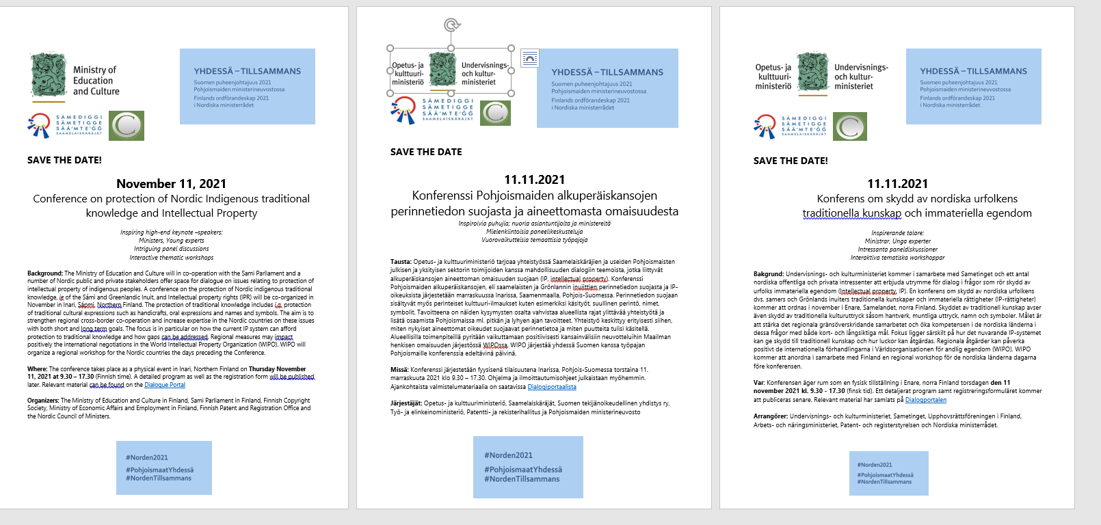
Save the dates

Slide 4
WIPO TK workshop
WIPO TK workshop for the Nordics
When: 8-10 November, 2021
Where: Physical event in SAJOS, Inari, Finland (Sápmi)
Focus: representatives of Nordic ministries responsible for IP policy and a respective number of indigenous representatives from the respective countries, 3+3 from each country – 30 persons
Aim: To launch Nordic co-operation in the protection of indigenous traditional knowledge within the IP system; would introduce the topic to be continued in incoming Presidencies programs
Programme as previously at WIPO TK workshops (Iqaluit Canada), 1 day among government/ indigenous and 2 days together
Tasks could be to discuss a more unified Nordic approach in protecting indigenous TK (at Nordic, EU and WIPO level) and also formulate the content for a booklet on Nordic indigenous TK and IP issues, using existing materials such as
Studies by Piia Nuorgam and Jacob Adams (”Revitalisering av Samisk duodjimerke” Samerådets prosjekt/the Saami Council), and study by Tuomas Mattila/ University of Helsinki and others see Dialogue portal
WIPO booklet Genetic Resources, Traditional Knowledge and Traditional Cultural Expressions https://www.wipo.int/edocs/pubdocs/en/wipo_pub_933_2020.pdf

