Slide 1
Results of the workshop on Sámi intangible cultural heritage
Nordic expert seminar, 22 October 2020
Harriet Deacon (and Rieks Smeets)
UNESCO facilitators
Karasjok, 13-15 Nov 2019
Photo: Anna Ciucka Sjursen
Sami weaving
Notes:
https://www.instagram.com/p/BzQQ1LHClVS/

Slide 2
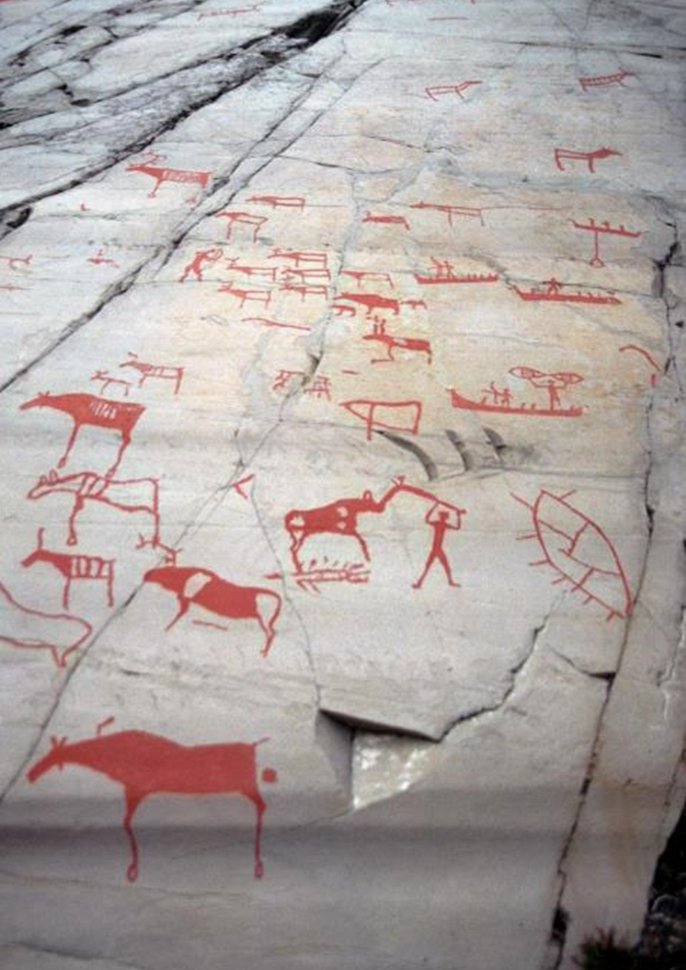
Workshop themes
Sámi ICH/TK
Intellectual property law / WIPO
Cultural heritage / UNESCO
Broader issues
Case studies
Trade secrets
Trademarks
Copyright
Sámi community, parliament and organizations
Archives
Museums
Education
Natural and cultural heritage sites
Intangible heritage
Disney
Sun symbol
Sámi Duodji
Zia sun symbol
Cowichan
Indigenous rights
Land rights
Human rights
Cultural rights
Karl Brodowsky Alta-Carvings 2012

Slide 3
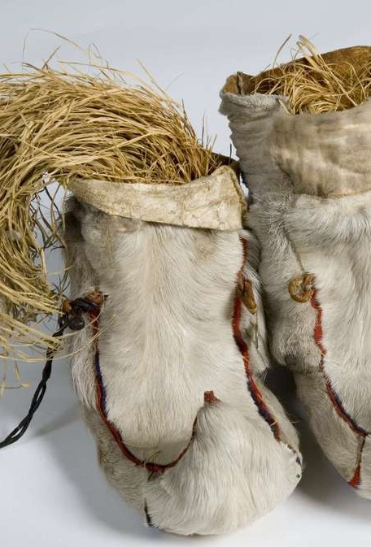
Main results (facilitators’ perspective)
Importance of acknowledging interconnections between indigenous histories, broader rights issues, tangible, natural and intangible heritage, museums, archives and education about culture.
Case studies can inform pan-Sápmi strategic planning on the practice, transmission and safeguarding of Sámi intangible heritage and intellectual property rights protection of TK and TCEs. This can support heritage-sensitive promotion in the market of Sámi duodji and other forms of Sámi ICH.
Consultations with community representatives across Sápmi, policymakers and intellectual property offices in Norway, Sweden and Finland could lead to more effective positive and/or defensive protection of Sámi-related cultural heritage (including symbols).
Various possible avenues exist for greater Sámi engagement with UNESCO and WIPO, if community participation and consent processes indicate possible benefits for Sámi.
Skaller. Sami fur shoes with grass called sennegress. Samiske skaller med sennegress fra Sør-Varanger. Norway. Item: NFSA.0360AB Norsk Folkemuseum, Norway.
Foto: Reinsfelt, Anne-Lise / Norsk Folkemuseum
Dette bildet er lisensiert under en Creative Commons 3.0 lisens

Slide 4
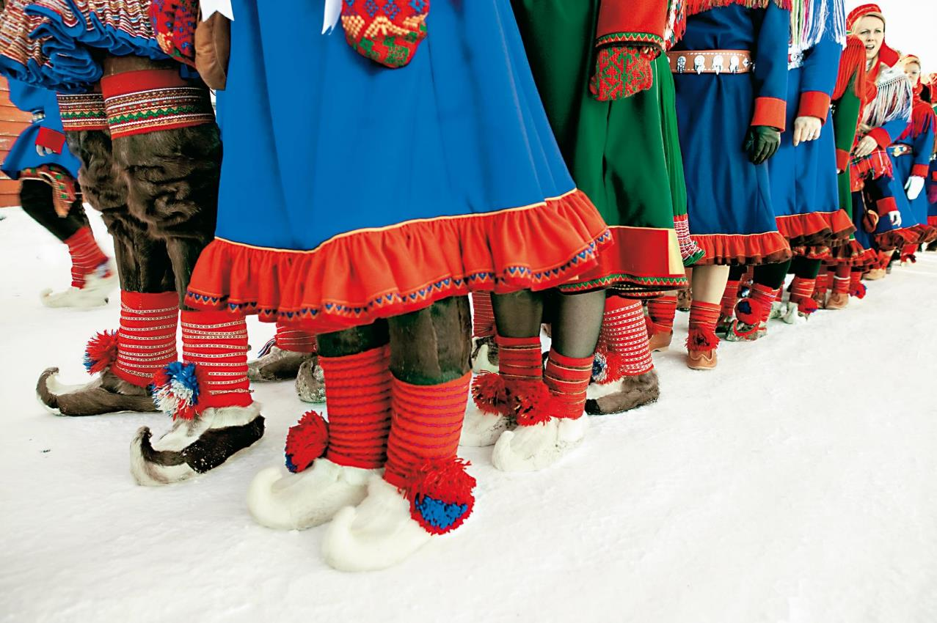
Workshop reports
Photo by Karin Beate Nøsterud, 2010.
The Norwegian Arts Council: https://www.kulturradet.no/museum-kulturarv/vis-artikkel/-/rapport-om-samisk-immateriell-kulturarv
English report: https://www.kulturradet.no/english/publications
The Sámi Parliament: https://www.sametinget.no/Nyhetsarkiv/Rapport-om-samisk-immateriell-kulturarv
Notes:
Saamiblog https://www.flickr.com/photos/28772513@N07/10765165644/in/photostream/
Norske samer. Norwegian Sami
Photo by Karin Beate Nøsterud, 2010. Source Nordic co-operation website (norden.org): Licensed under Creative Commons Attribution 2.5 Denmark

