Slide 1
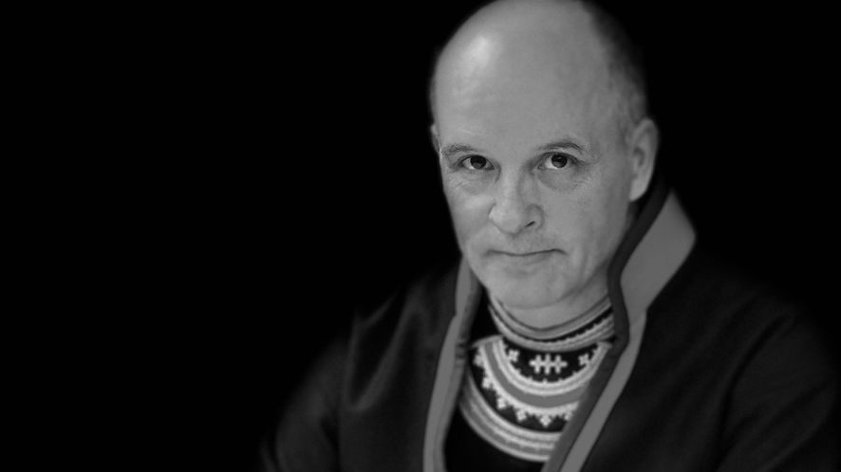
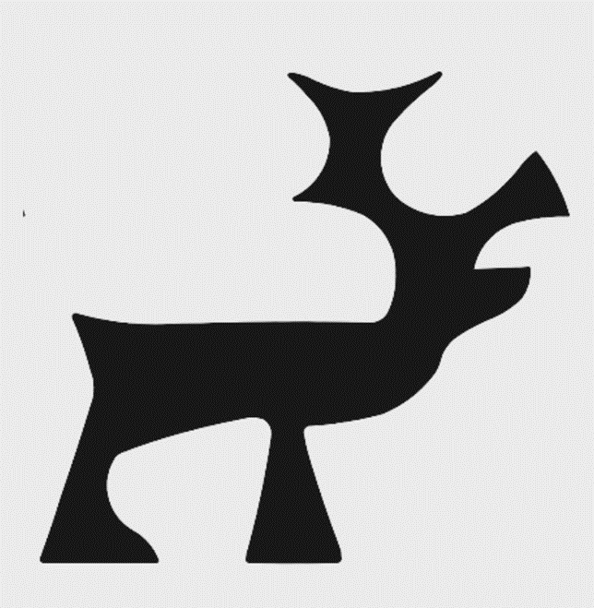
Registrations in Sweden
Rune Fjellheim
JOJK
Bieggolmai Holding AB
Jokkmokk Sami Cheese
Notes:
Alcoholic beverages class 33 – Nubbe means ”shot” (like a shot of vodka)
A trade mark can not be registered if it
- is likely to be confused with another trade mark registered before, another trade name
- infringes someone else´s copyright
- includes the name or picture of someone else (who is alive or recently dead)
- includes some one else´s pseudonym or artist name or someon else´s protected family name (according to the Swedish law on personal names)
The portrait shows a depiction of Nils Nilsson Skum, a famous Sámi artist represented at the World Expo in Paris 1937
He died 69 years ago. According to Swedish trademark act you cannot protect a mark consisting of a protected surname or a picture of someone else who is not dead since a long time. According to case law, the name or portrait is protected for 70 years after ones death (just like the copyright time limit).

Slide 2
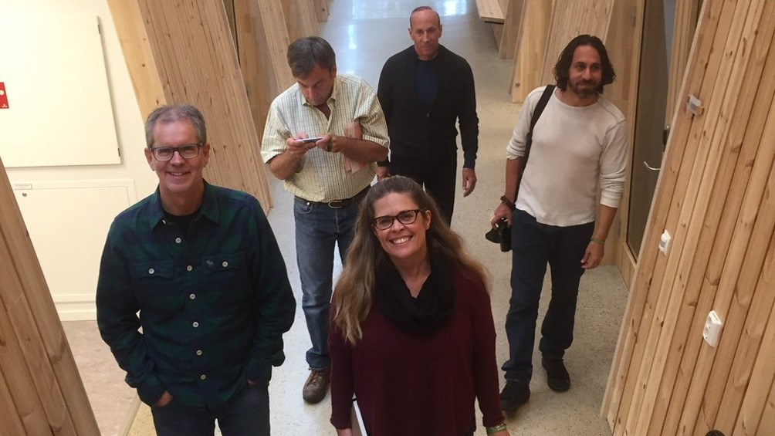
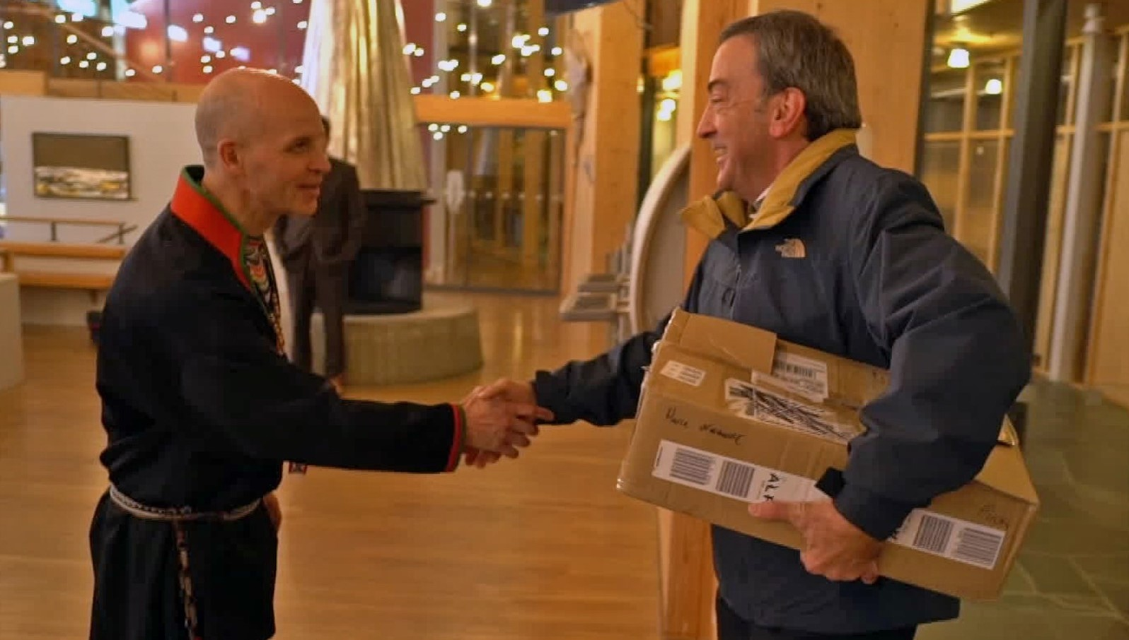
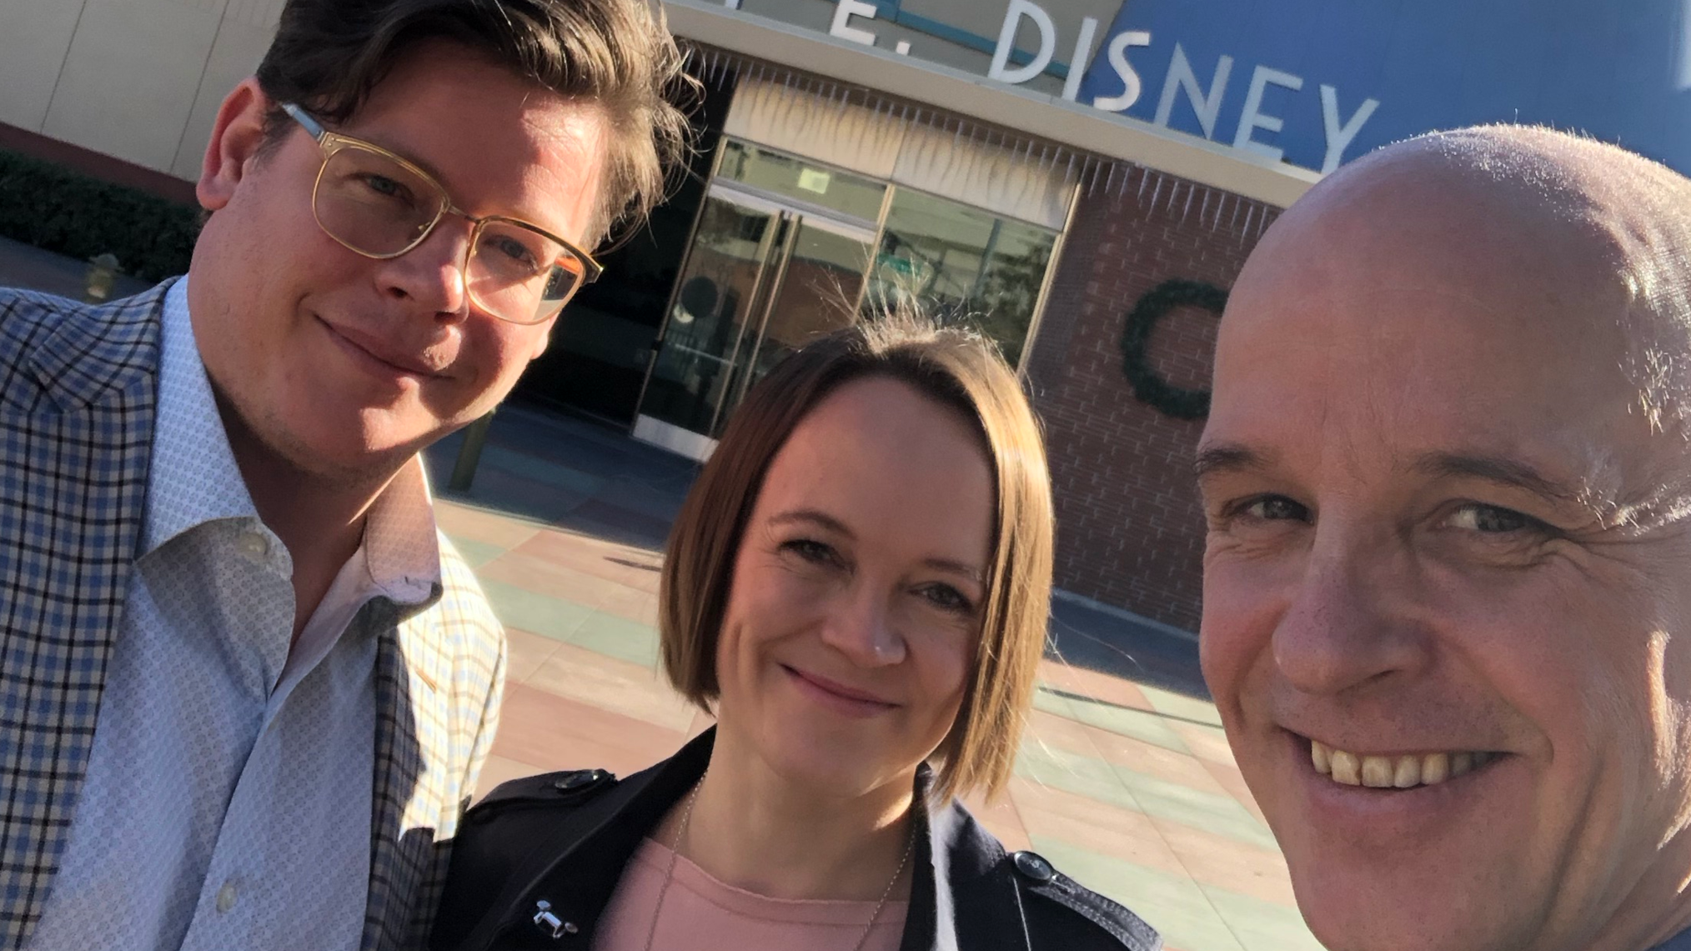
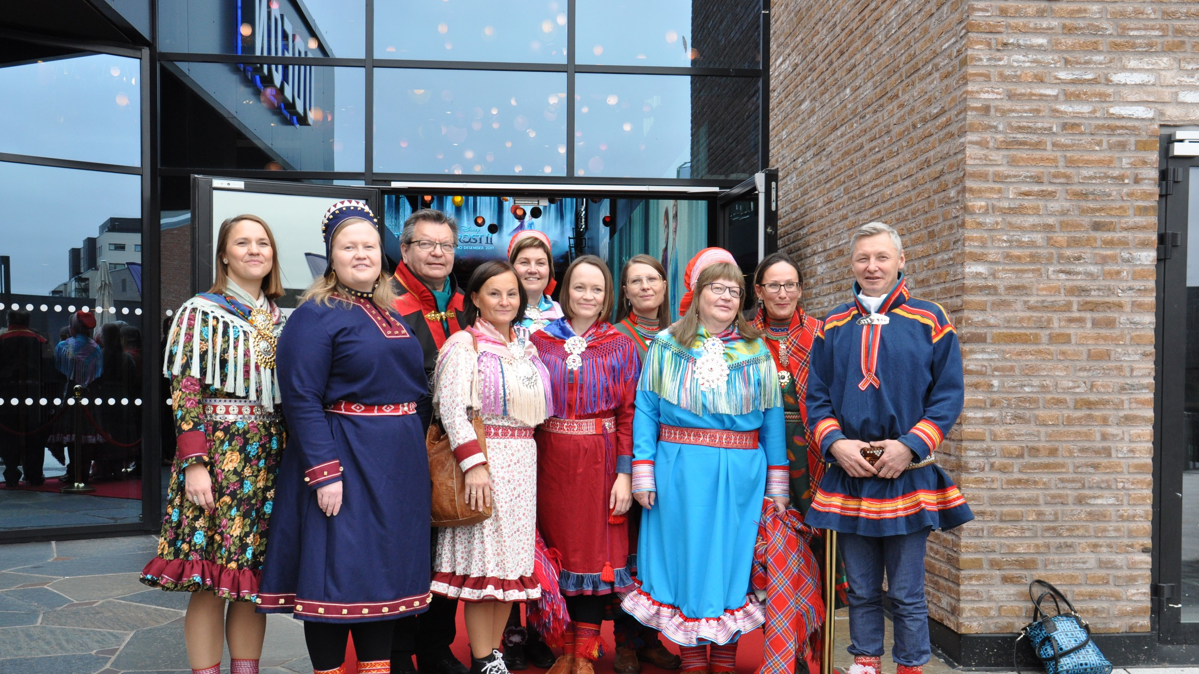
First visit
Coming back
Verddet
Going to Hollywood

Slide 3
