Slide 1
Laserperusteinen maaperän hiilivaraston nopea määritys – Hiililaser
Laser-based assessment of soil carbon content
Vishal Dwivedi, Joni Ahokas, Jan Viljanen, Piotr Ryczkowski, Juha Toivonen
Photonics Laboratory, Tampere University

Slide 2
Motivation
Soil is the second largest carbon storage on Earth (after Oceans) and plays a crucial role in the global carbon cycles.
Current cultivation methods need to be upgraded in order to reverse the C cycle
(i.e. instead of releasing C into the atmosphere, it can be stored in the soil).
Key challenges in Carbon Farming scheme for soil carbon sequestration on mineral soils
  Expense and uncertainty of measuring soil carbon
  Difficulty of monitoring soil carbon
Laser-Induced Breakdown Spectroscopy (LIBS)
3.11.2023
| 2

Slide 3
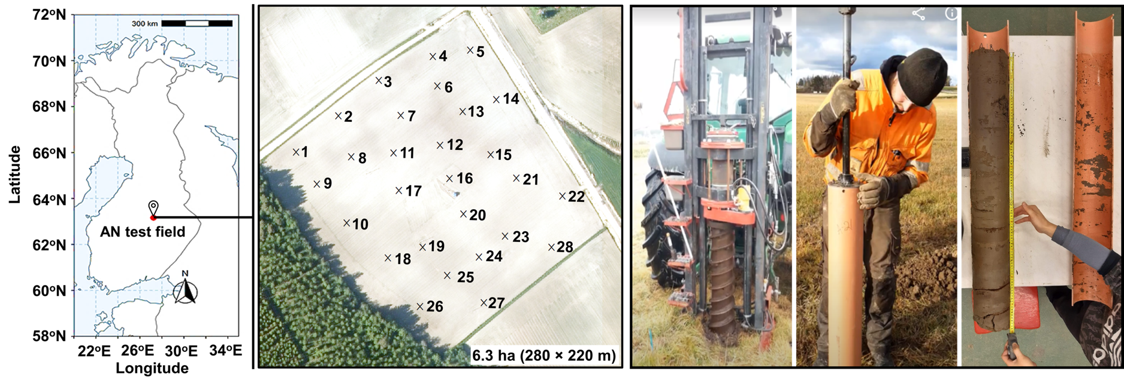
Sampling of fields – VALSE samples

Slide 4
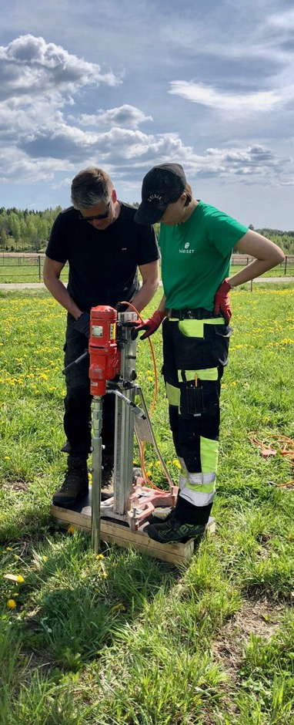
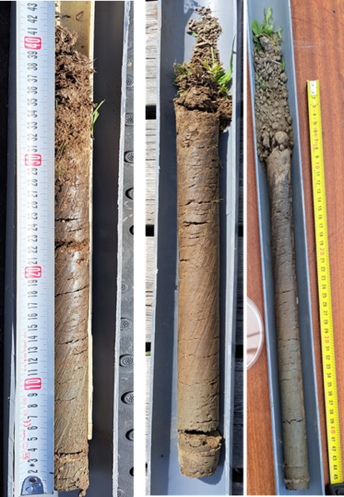
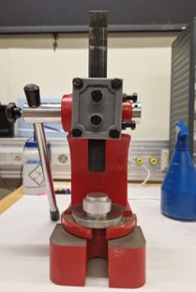
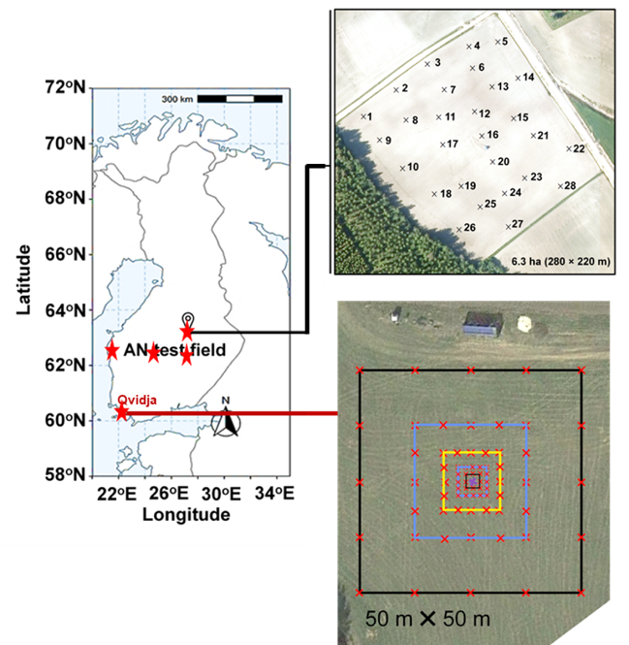
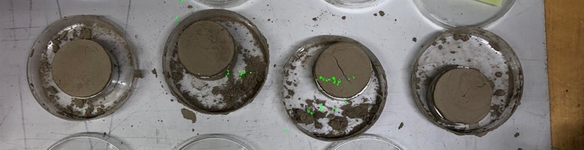
Soil sampling
Pellet samples

Slide 5

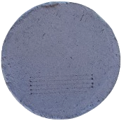
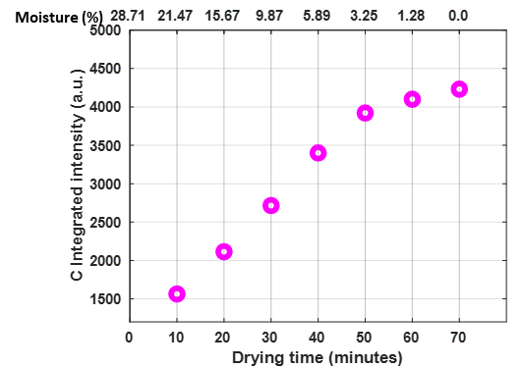
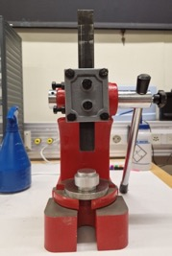
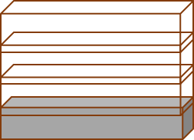

Soil sample preparation for LIBS analysis
Mixing
Pelletization
Drying
Drying cabinet
70°C
~ 60 min / 60 samples
Avoid sieving, grinding, dry combustion
Still, sample preparation have strong influence on quality of the results
3.11.2023
| 5

Slide 6
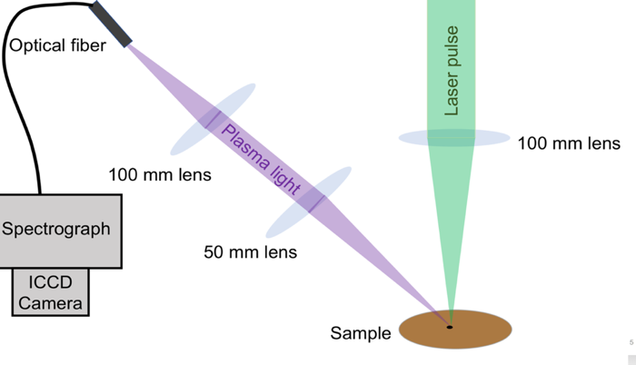
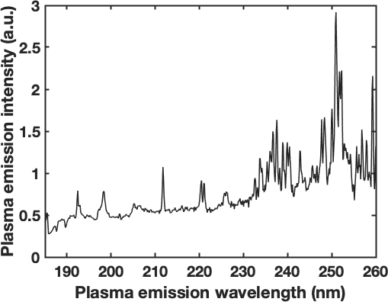
Laser-Induced Breakdown Spectroscopy (LIBS)
We developed a laser-based measurement method that enable comprehensive on-site monitoring of soil carbon content.
Measurement at the sampling site
  Absolute carbon content
  Carbon depth distribution down to 1 m
LIBS is information rich
  Nutrient content
  Soil classification
Spectrometer
Plasma
Si
C (193 nm)
Fe

Slide 7
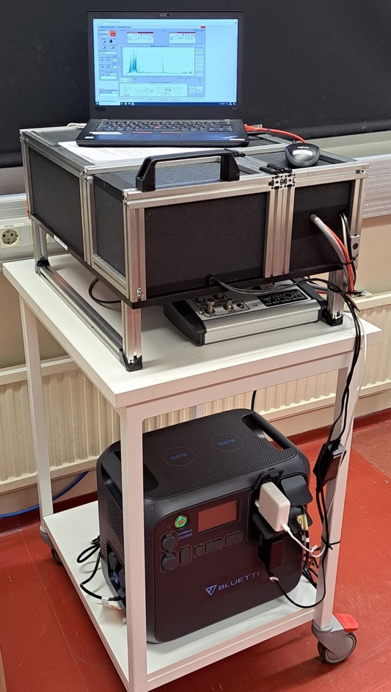
LIBS instrumentation built for soil carbon analysis
* Battery ~ 35 hours
3.11.2023
| 7

Slide 8
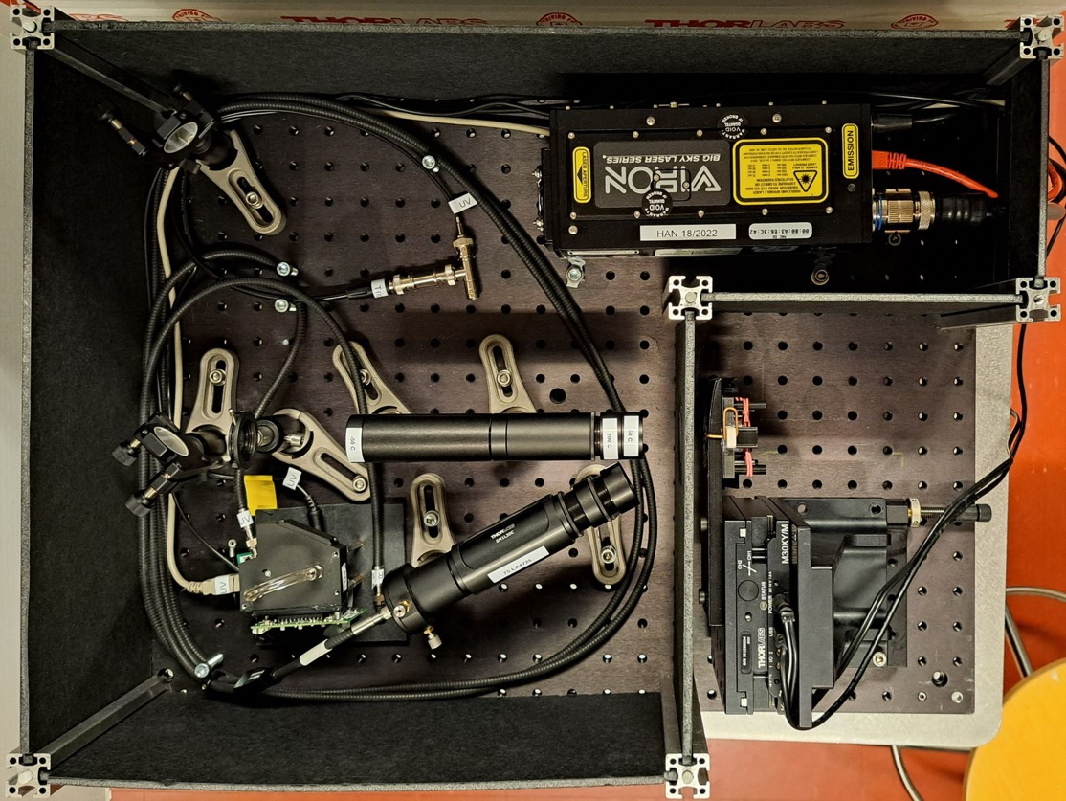
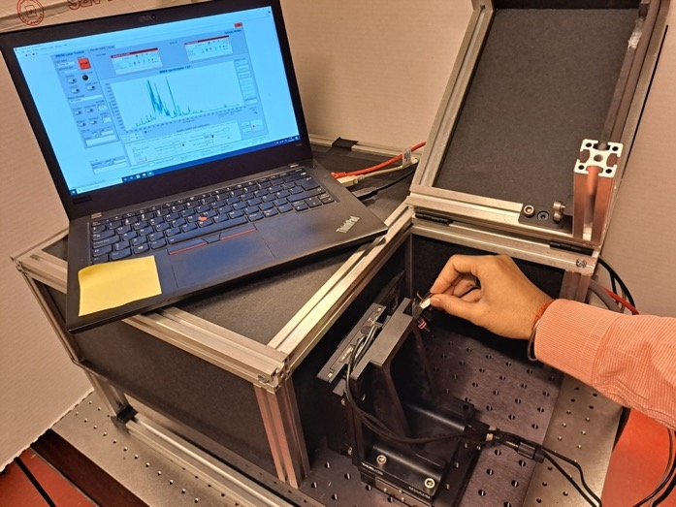
Field-capable LIBS device
Laser 1064 nm, 50 mJ, 1-20 Hz
Spectrometers
  178 – 400 nm (C, Si, Al, … )
  360 – 820 nm (H, K, Na, … )
Laser
Sample
Plasma plume
Spectrometer

Slide 9
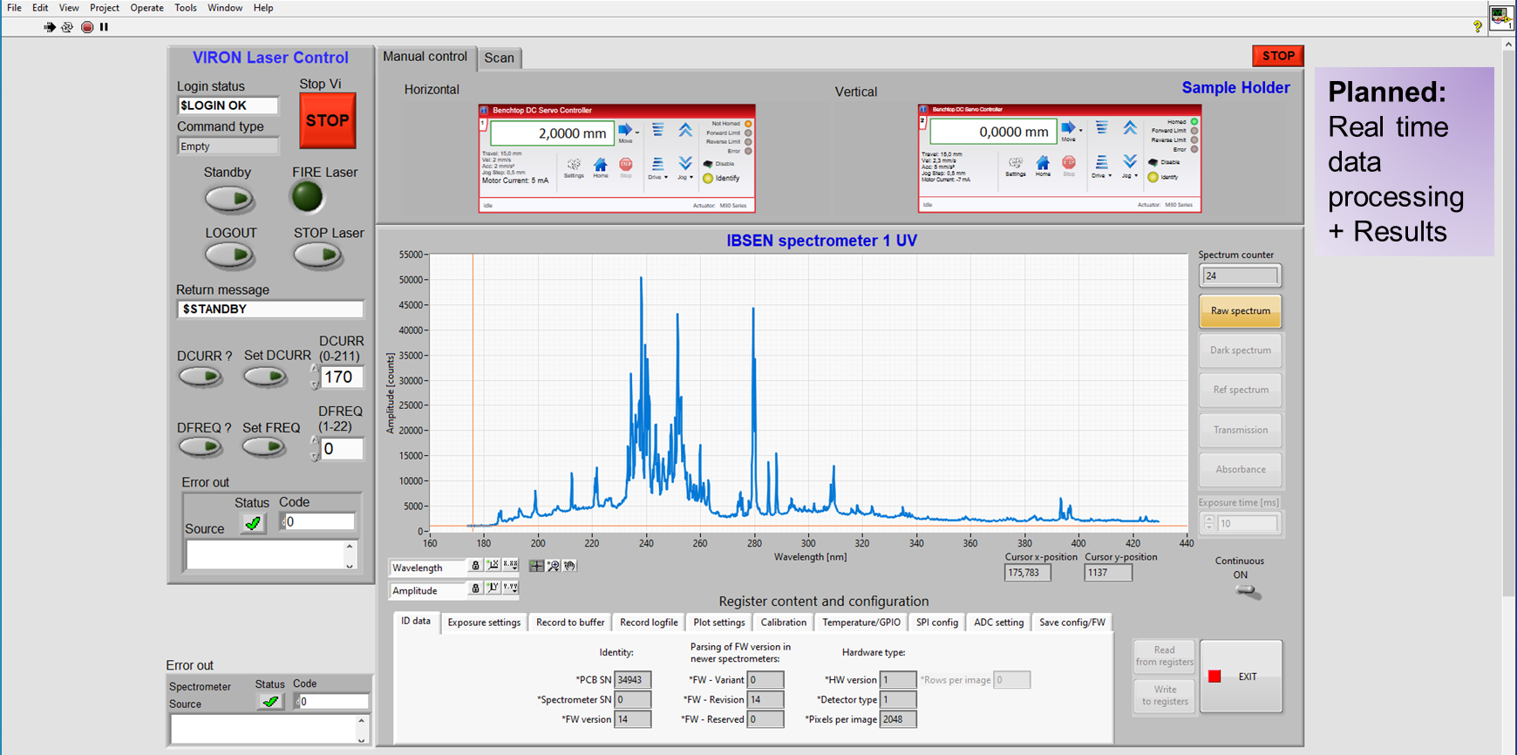
Software programmed with LabVIEW
3.11.2023
| 9

Slide 10
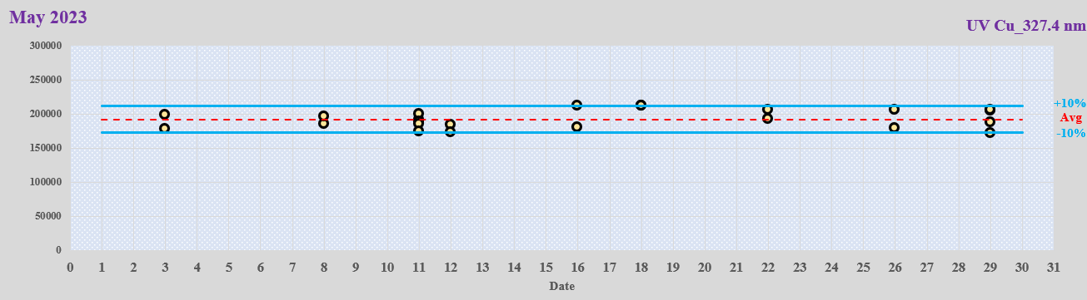
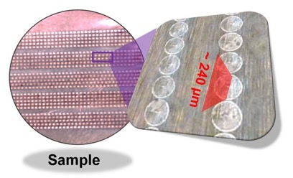
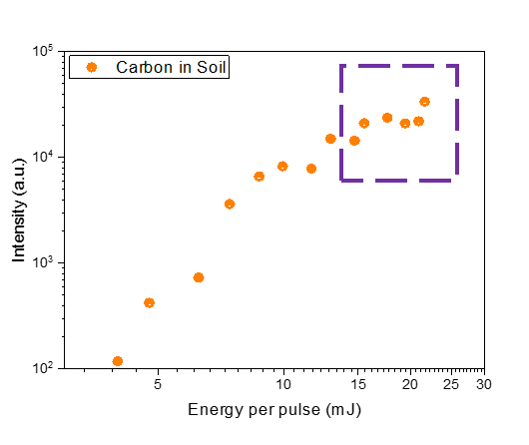
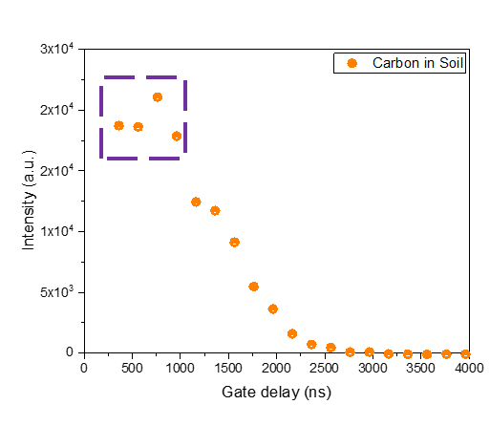
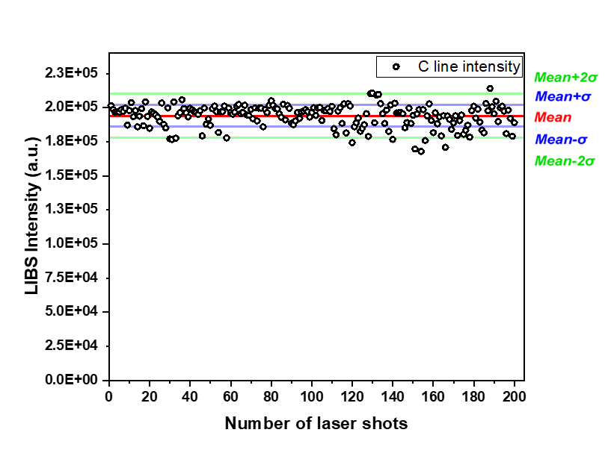
Calibration and Optimization
Pure Cu
Laser energy per pulse
Acquisition delay time
Shot to shot variation
Repeatability
Uncertainty in the LIBS carbon peak intensity is ± 3%
3.11.2023
| 10

Slide 11
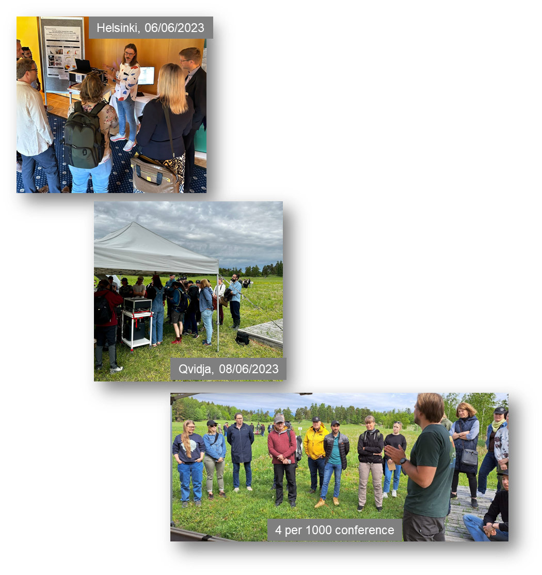
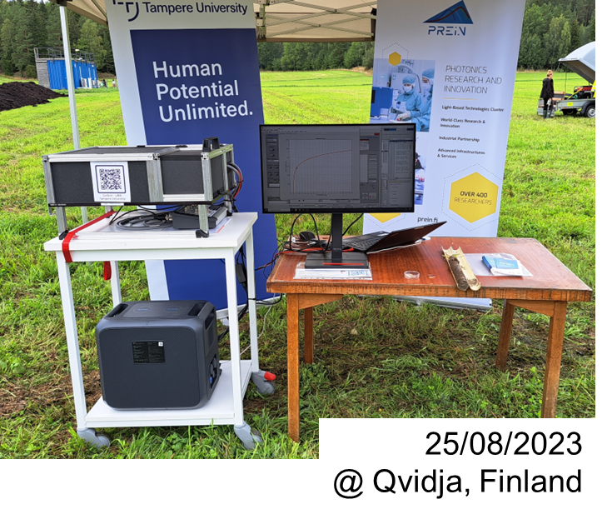
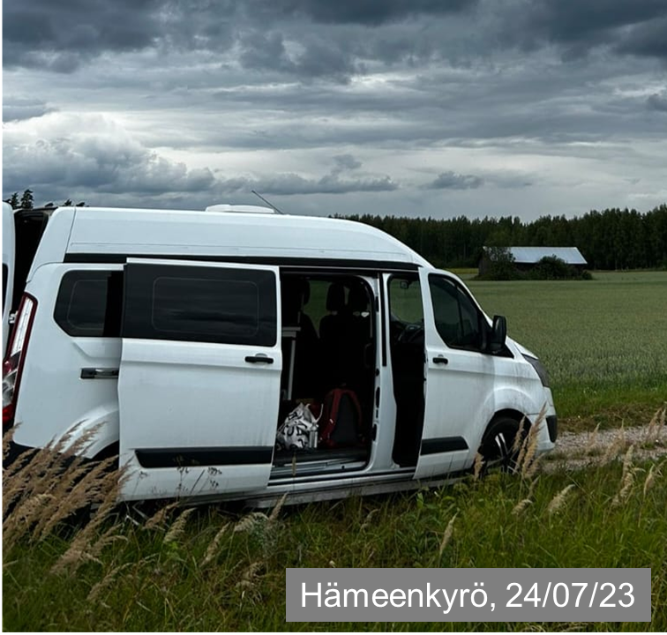
Demonstrations and
measurements
at field locations
3.11.2023
| 11

Slide 12
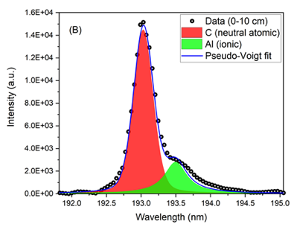
Average: 200 spectra
Laser energy: 28 mJ/pulse
T_{d}= 600 ns
T_{exp}= 12 µs
LIBS Spectrum
~6.4 wt.% C
A12
0-10 cm
Due to presence of many elements and thousands of spectral lines for some elements (e.g., Fe, Co, etc.), strong interference among the lines needs to be checked and corrected.
3.11.2023
| 12

Slide 13
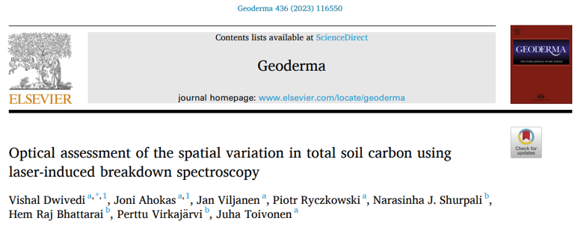
Variation of C content with depth in soil
Soil from first 30 cm have significantly
higher C content than the rest
3.11.2023
| 13

Slide 14
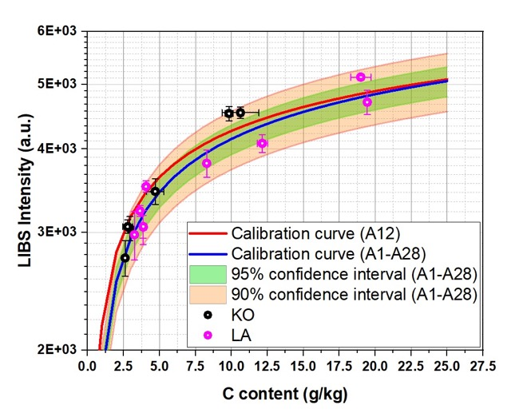
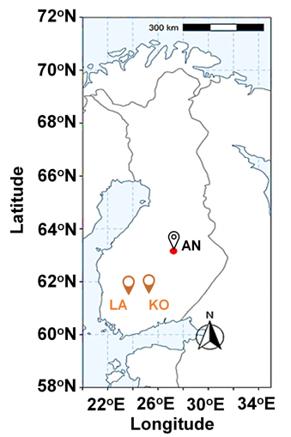
LIBS Calibration
Samples collected form Anttila (AN, LUKE) field, 28 locations, down to 1 m depth, 167 in total.
The calibration curve obtained using 8 samples from one randomly chosen sampling location (A12)
Reference values from Leco measurements
Calibration curves from A12 and locations A1-28
Fresh samples from Carbon Action KO and LA fields (only pressed to a pellet and dried) fall within 95% confidence interval of A1-A28 calibration curve
Calibration can be used in all (at least most) fields with similar soil type

Slide 15
Spatial variation of a field carbon content
LIBS measurement of one sample ~1min (laser ablation, data acquisition and data processing)
Measurement speed bottlenecks are in the sampling (drilling, pelletizing, drying) and sample integration in LIBS prototype

Slide 16
Conclusions
We have demonstrated that the laser-based LIBS analysis allows accurate and fast soil carbon measurement even at field conditions
    10 min for drilling and sample separation
    2 min for sample preparation
    ~ 60 min for drying
    2 min for LIBS analysis
We learned that soil type and moisture level affects to LIBS calibration
Next steps
Increase the level of automation to speed up drill sampling & LIBS
Study how to compensate moisture and soil type variation to speed up the method
Analysis of the whole drill depth (4 – 8 samples) possible in 6 – 10 minutes
3.11.2023
| 16

Slide 17

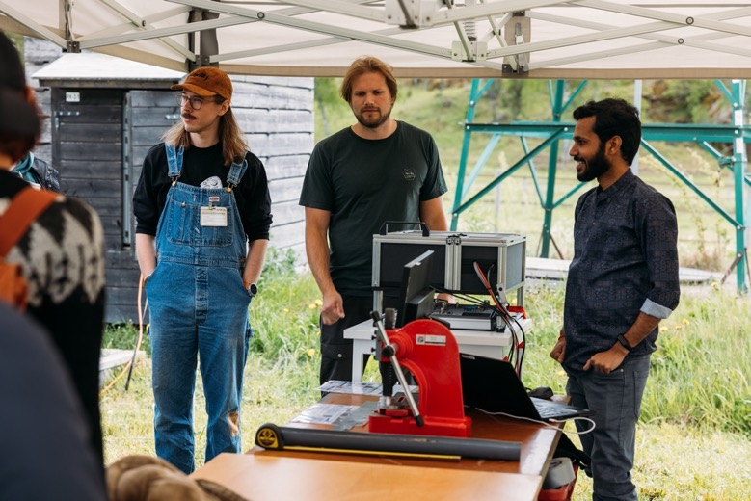



Acknowledgements
The Ministry of Agriculture and Forestry, Finland
Research Council of Finland
(Jan Viljanen, decision 338338)
Finnish Flagship on Photonics Research
and Innovation (PREIN)

